Slide 1
EVOLUTION STRATEGIES
Steve Aronson

Slide 2
Evolution Strategies as a Scalable Alternative to Reinforcement Learning
Optimization technique designed to improve on standard reinforcement learning
In the class of gradient free optimizations
Easier to implement – no back propagation
Does not require forward function to be differentiable
Does not suffer gradients collapsing to zero
Easier to scale
Fewer hyperparameters
Fewer variables to share between parallel workers
Not as efficient for supervised learning tasks
Gradient descent with exact errors is still better
References
Short blog - https://openai.com/blog/evolution-strategies/
Original paper - https://arxiv.org/abs/1703.03864
GitHub - https://github.com/openai/evolution-strategies-starter

Slide 3
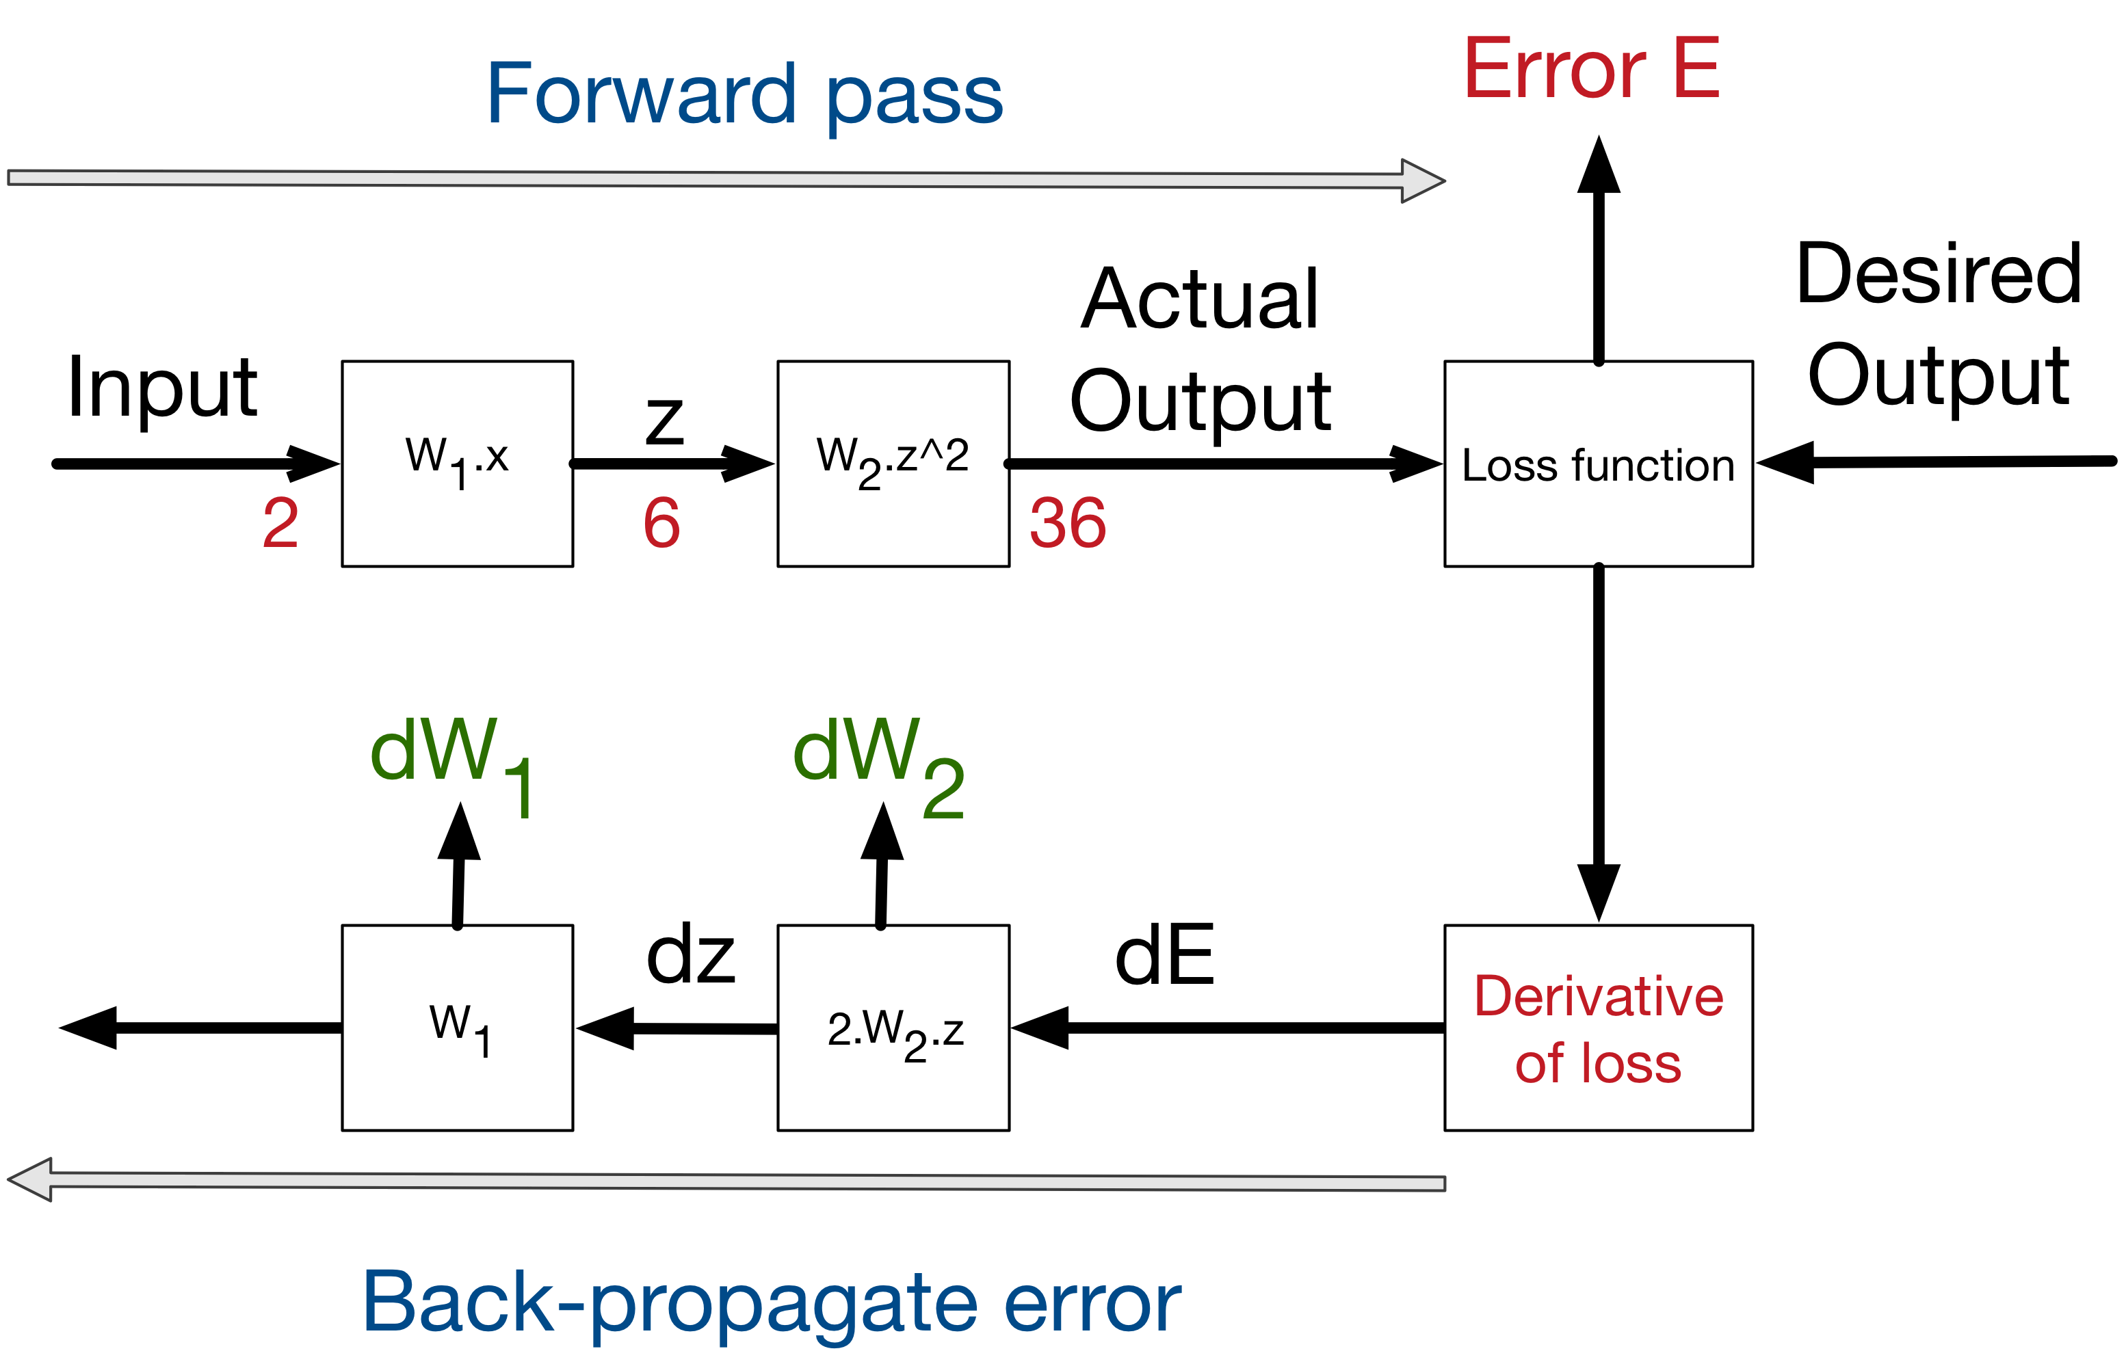
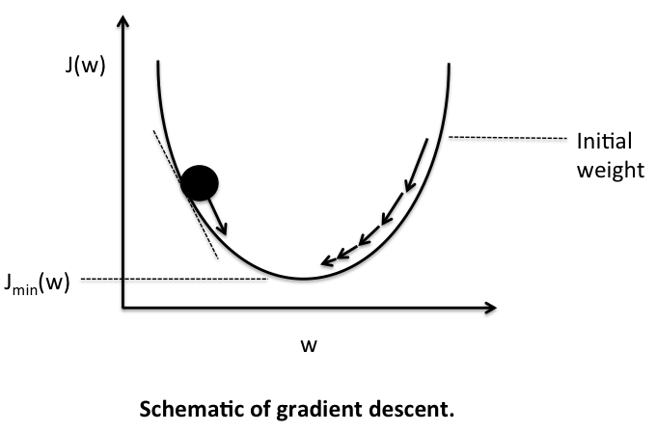
Quick Primer on Machine Learning Optimization
Loss
In any machine learning task, we are trying to find weights w that create outputs as close as possible to the desired outputs
We define a Loss function that measures how far away the machine is from the desired output for the current weights
The goal is to minimize the Loss function
Gradient Descent
The minimization is done by using the Loss result to direct how to adjust the weights so that the next Loss is reduced
This technique is gradient descent

Slide 4
What is Evolution for reinforcement learning?
 | Policy Learning (e.g. Q-learning) | Parameter Learning (ES)
Learning Method | Inject noise in the actions | Inject noise in the model parameters
Performance measurement | Change in rewards with different actions | Change in rewards with different parameters
Updates | Back propagation (gradient) using the change in rewards is used to update the parameters | Gradient is estimated from rewards and applied directly to parameters
Parallel processing | Each worker runs an episode. Model parameters are coalesced, merged, and redistributed to workers. | Each worker runs an episode, only resulting rewards are coalesced, gradient estimated and distributed to workers.
Learning Risks | Action exploration needs to be broad enough to identify best rewards | Parameter noise needs to be large enough to cause reward changes

Slide 5
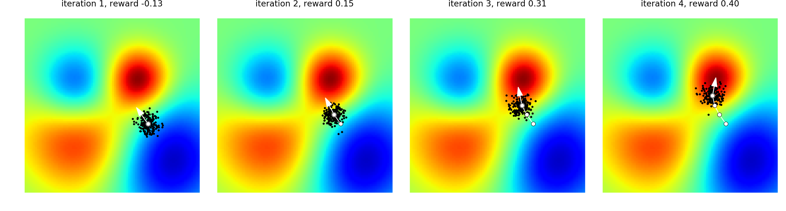
Evolution Strategy
Estimate the Loss function gradient using forward pass only
Starting with an input, create many copies
Add jitter to the copies to create a small cluster of inputs
Calculate the machine output for the cluster
Estimate the gradient from the outputs
Next input = previous input + learning rate * gradient
The picture below demonstrates a few steps
Here the Loss function is rewards, so the goal is maximizing the rewards

Slide 6
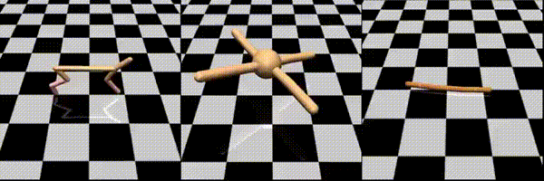
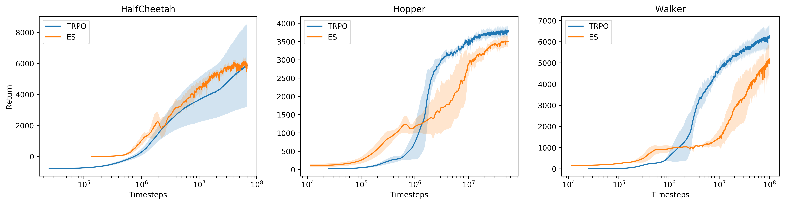
Comparing traditional RL (TRPO) to evolution strategies (ES)

Slide 7
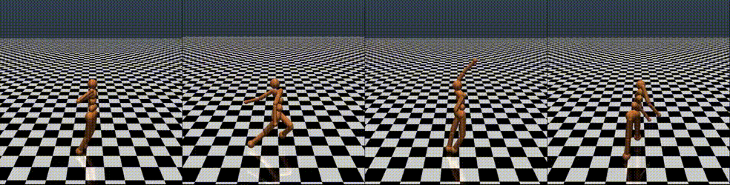
Maybe a better comparison
How parallel is each algorithm?
Since ES requires negligible communication between workers, we were able to solve one of the hardest MuJoCo tasks (a 3D humanoid) using 1,440 CPUs across 80 machines in only 10 minutes. As a comparison, in a typical setting 32 A3C workers on one machine would solve this task in about 10 hours.

Slide 8
Final notes
This technique seems very attractive
Is there a catch?
Google search turns up very little activity since this paper was released in 2017

